Slide 1
BioPAX
A Data Exchange Ontology for Biological Pathways
BioPAX Workgroup
www.biopax.org
PSI April 2004

Slide 2
BioPAX
BioPAX = Biological Pathway Exchange
Data exchange format for pathway data
Include support for these pathway types:
  Metabolic pathways
  Signaling pathways
  Protein-protein interactions
  Genetic regulatory pathways
  Genetic pathways
Accommodate representations used in existing databases such as BioCyc, BIND, WIT, aMAZE, KEGG, PSI-MI, PATIKA, GK, etc.

Slide 3
Exchange Formats in the Pathway Data Space
Database Exchange
Formats
Simulation Model
Exchange Formats
SBML,
CellML
PSI
Biochemical
Reactions
Protein
Interaction
Networks
Rate
Formulas
Metabolic Pathways
Low Detail High Detail
Regulatory Pathways
Low Detail High Detail
Notes:
This slide shows the difference between exchange formats in the pathway data space. Pathway databases and tools are not considered here, although each one is important and addresses specific use cases.
BioPAX level 1 is broad and shallow allowing us to quickly build a format that can represent most the existing data types in databases today. Details will be added in subsequent levels. This is a practical approach.

Slide 4
Exchange Formats in the Pathway Data Space
Database Exchange
Formats
Simulation Model
Exchange Formats
BioPAX
Small
Molecules
(CML)
SBML,
CellML
PSI
Molecular Interactions
Pro:Pro All:All
Genetic
Interactions
Biochemical
Reactions
Rate
Formulas
Metabolic Pathways
Low Detail High Detail
Interaction Networks
Molecular Non-molecular
Pro:Pro TF:Gene Genetic
Regulatory Pathways
Low Detail High Detail
Notes:
This slide shows the difference between exchange formats in the pathway data space. Pathway databases and tools are not considered here, although each one is important and addresses specific use cases.
BioPAX level 1 is broad and shallow allowing us to quickly build a format that can represent most the existing data types in databases today. Details will be added in subsequent levels. This is a practical approach.

Slide 5
Desired Features
Extensible: Specific classes of data in BioPAX have been marked as extensible to allow addition of new types of data in the future
Encapsulation: An entire pathway can be encapsulated in a single BioPAX record
Compatible: BioPAX will try to use existing standards for encoding biological pathway related information wherever possible
Flexible: Different preferred representations of pathway data can be described using BioPAX
Computable: From file reading to logical inference
Notes:
Encapsulation: All proteins, small molecules, etc. should be able to be stored in a BioPAX record so that people don’t have to fish around for a Swiss-Prot entry when they want information about a protein. This is not space efficient, so is optional – you can choose at download time whether you want the explicit form or not.
Compatible: We specifically want to be file format compatible with PSI. We want to use the same constructs as SBML where possible to maintain compatibility there. CellML can be converted to SBML, so there is already some aspect of compatibility there,
Flexible: this is extremely important for community acceptance because people will not change their representation methods to enable data exchange. Thus, BioPAX will not solve the problem of semantic matching between ontologies, but it is a very good first step towards that goal, towards the goal of having everyone speak the same language (this may not be possible, though, to encompass all cases because one language may not be able to solve everyone’s problems).

Slide 6
Ontology Development Process
Developed Conceptual Framework
  Based upon existing DB schemas
    aMAZE, BIND, EcoCyc, WIT, KEGG, etc.
  Allows wide range of detail, multiple levels of abstraction
Constructed an ontology
  GKB, Protégé → OWL
  Practical leveled approach (~Postscript, SBML)
  Discussion items tracked using SourceForge
  Support OWL (and later XML Schema)
Notes:
Our main goal is to integrate and cover existing DBs.

Slide 7
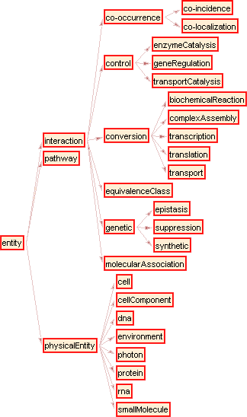
BioPAX Ontology
Released Level 1 v0.5 on Sep.24.2003
Released structure of class hierarchy:
Notes:
This slide puts it all together

Slide 8
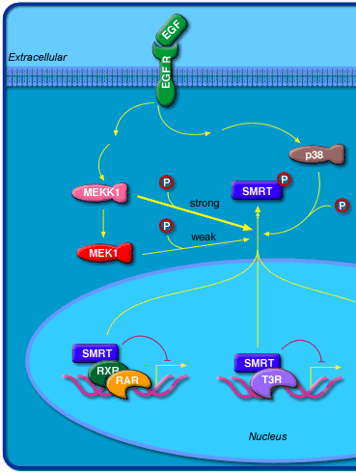
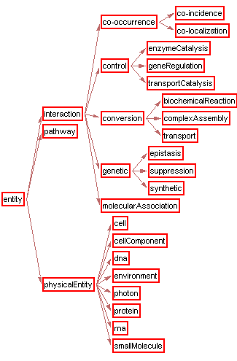

Slide 9
BioPAX Roadmap
Dec 2003

Slide 10
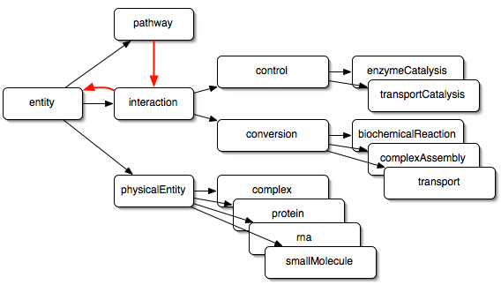
BioPAX Ontology
Current structure of class hierarchy:
Notes:
This slide puts it all together

Slide 11
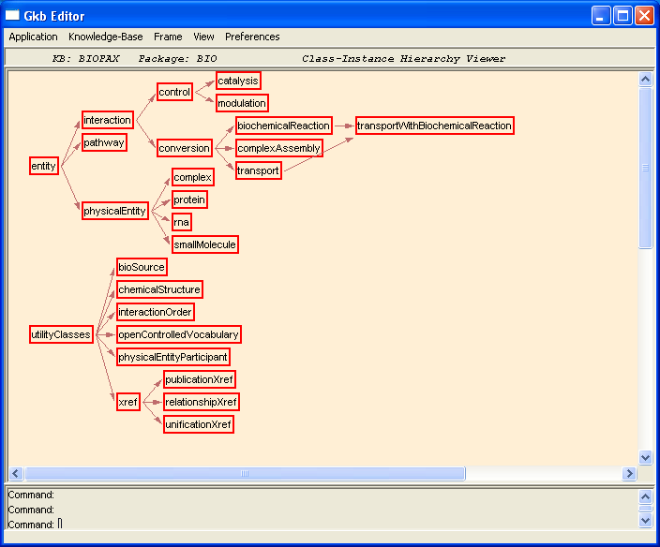

Slide 12
Organizational Structure
Small core group advancing standard
Increased representation from mailing lists
Bi-weekly conference calls, bi-monthly F2F
Cost paid by participants with some support from DOE
Special interests have subgroups
  Core group member + outside experts
  Tackle specific challenges

Slide 13
BioPAX Subgroups
State Representation:
  Determining best mechanism to represent biological states
    E.g. post-translational modification states of proteins, cell-cycle states
Small Molecule:
  Evaluated CML 2.0, ChemBank, etc.
Examples:
  Gather examples to test and illustrate BioPAX
Notes:
The states subgroup currently has reached a recommendation stage for BioPAX, which now needs to be turned into a document and a part of the ontology.

Slide 14
Current Status
Initial meeting Nov. 2002
Maintained conference call level
Version 0.5 of Level 1 Ontology released Sep.24
  Finishing slot definitions on Level 1 main-tree classes
Translating records from metabolic pathway DBs (BioCyc export, WIT import) to BioPAX
(BioCyc, WIT, PharmGKB)
Expected release of level 1.0: May 2004
Notes:
This is mostly a volunteer effort, so no one is working on this full-time. We are satisfied with progress so far, although it could be faster.

Slide 15
How to Contribute
Participate in email list discussions
  sign up via web site: http://www.biopax.org
Participate in meetings and subgroups
Make your data available in BioPAX format, when complete
Promote BioPAX to colleagues
Notes:
Since BioPAX will be compatible with PSI, if you have only protein-protein interactions to make available, you should use that format: more details at http://psidev.sf.net

Slide 16
BioPAX Supporting Groups
Groups
Memorial Sloan-Kettering Cancer Center: C. Sander, J. Luciano, M. Cary, G. Bader
SRI Bioinformatics Research Group: P. Karp, S. Paley, J. Pick
University of Colorado Health Sciences Center: I. Shah
Harvard Medical School: Aviv Regev
BioPathways Consortium: J. Luciano, E. Neumann, V. Schachter
Argonne National Laboratory: N. Maltsev
Teri Klein, Stanford University
Samuel Lunenfeld Research Institute: C. Hogue
Jeremy Zucker, Dana-Farber Cancer Center
Collaborating Organizations:
Proteomics Standards Initiative (PSI) (psidev.sf.net)
Systems Biology Markup Language (SBML)
CellML
Chemical Markup Language (CML)
Databases
BioCyc (www.biocyc.org)
BIND (www.bind.ca)
WIT (wit.mcs.anl.gov/WIT2)
Grants
Department of Energy (workshop grant)
Notes:
Many other people have contributed in discussions in person and on the mailing list and we would like to thank them as well.

Slide 17
Cytoscape
Biomolecular Network Visualization & Analysis
Benno Schwikowski (ISB)
Hamid Bolouri (ISB)
Trey Ideker (UCSD)
Chris Sander (MSKCC)
http://www.cytoscape.org

Slide 18



Cytoscape
Collaboration: ISB, UCSD, MSKCC
Java-based network and expression analysis tool, plugins
Front end and analysis tool for pathway, gene expression databases
Open source - LGPL
www.cytoscape.org
PSI-MI support via plugin - local file,URL I/O
  Via data service framework (modular library)

Slide 19
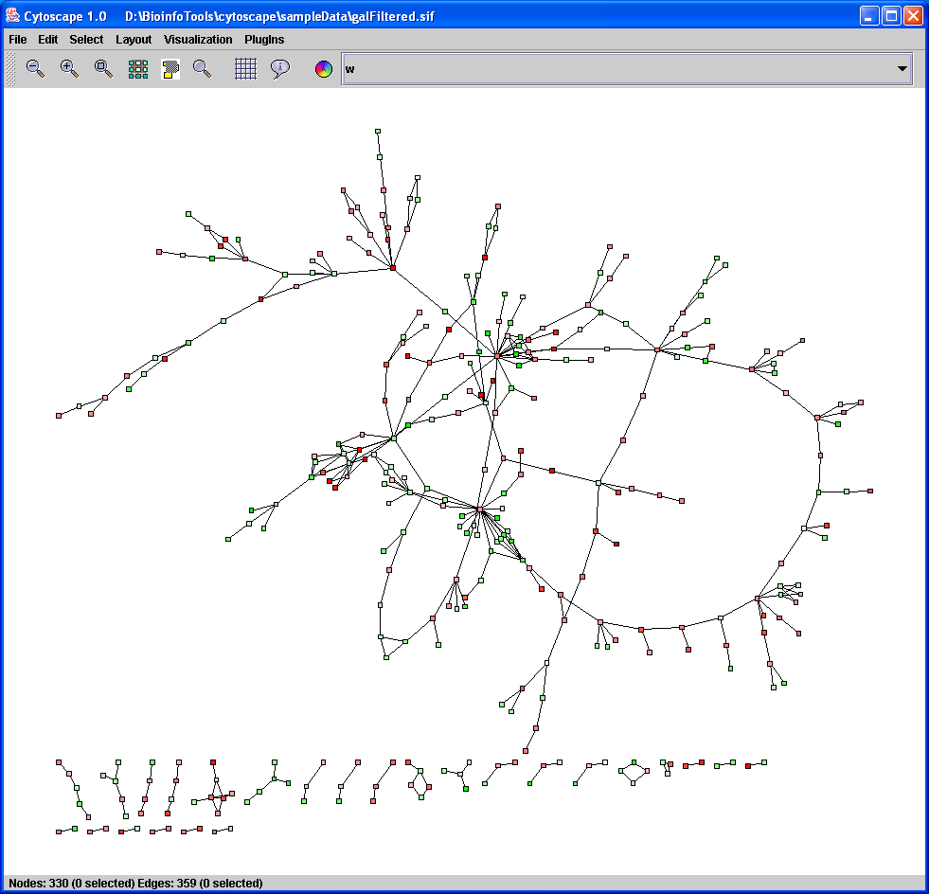
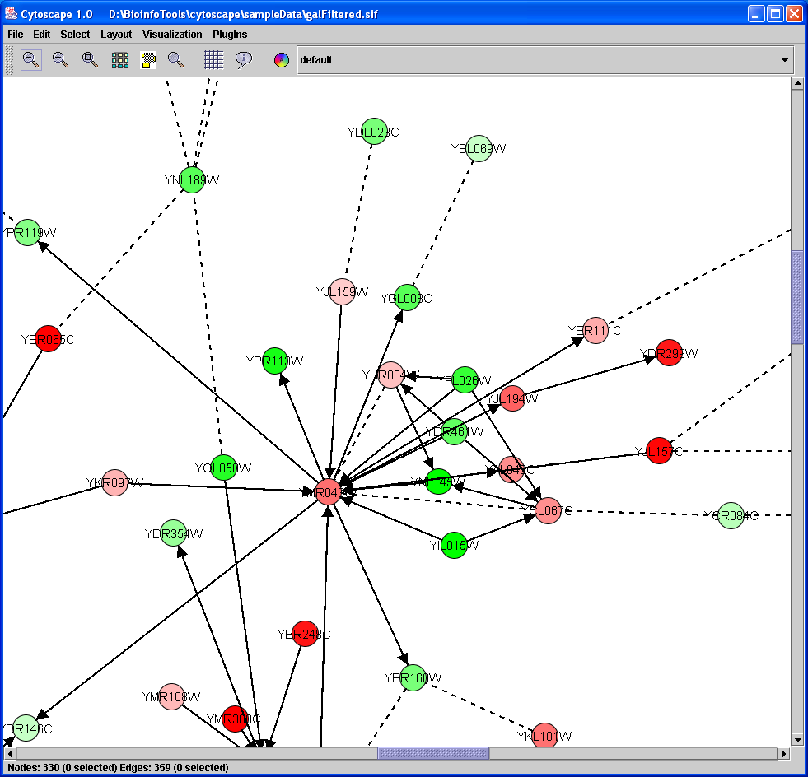

Slide 20
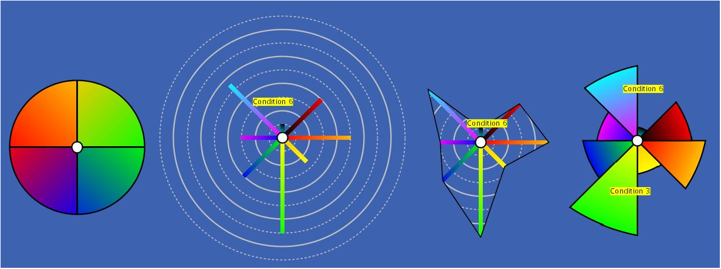
Visual Mapping
Graph has node and edge attributes
    E.g. expression data, interaction type
Mapped to visual attributes
    E.g. node/edge size, shape, color, font…

Slide 21
Network Analysis
Plugins for:
  Networks and Transcriptional Profiling
    Active Modules (UCSD)
    Activity Centers (MSKCC)
    Expression tools (ISB)
  Also
    MCODE: network clustering (MSKCC)
    PathBLAST (UCSD)
    BioModules (ISB)
  Open architecture to develop new plugins (v2.0 adds GINY - open source graph library in Java) - csbi.sf.net

Slide 22
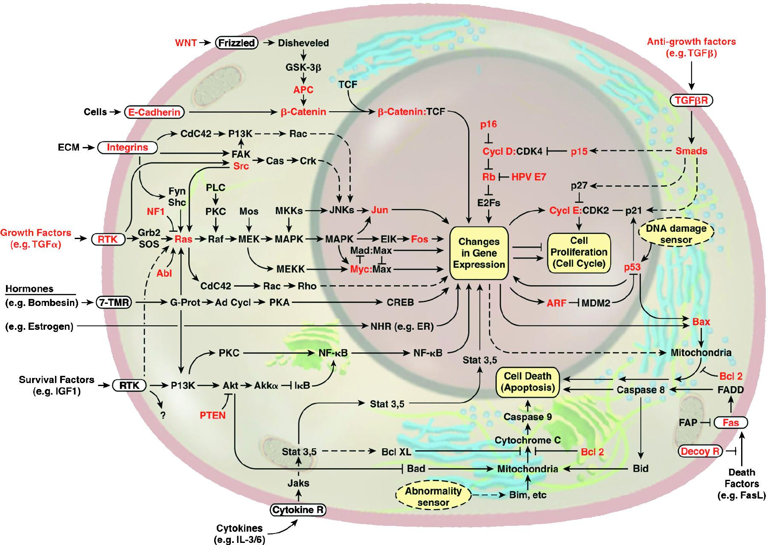
cPath - Cancer Pathway Database
Cell death/apoptosis
Growth regulation
Angiogenesis
DNA damage response
Cell Cycle – limitless replicative potential
Cytoskeleton - metastasis, tissue invasion
Weinberg, R.A. Cell 2000

Slide 23
cPath
Content: Cancer pathways
Use case: Pathway data integration tool
    Local research tool - IP restrictions, own expts.
Support PSI-MI, then BioPAX
Cytoscape plugin available for cPath query
Web-based MySQL/Java/Tomcat – URL based web service API returns XML (PSI)
www.cbio.mskcc.org/cpath
www.cbio.mskcc.org/dev_site/cpath
Ethan Cerami, Rob Sheridan

